Slide 1


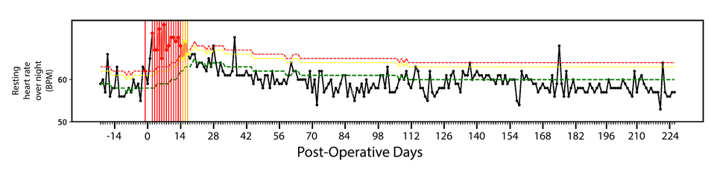
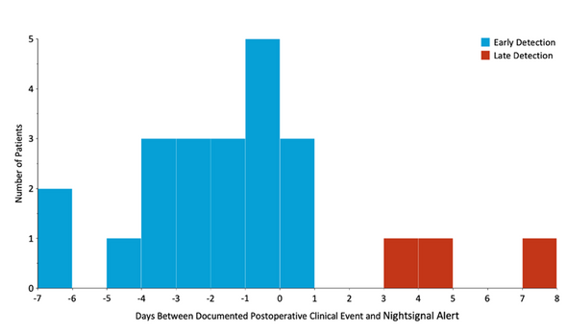
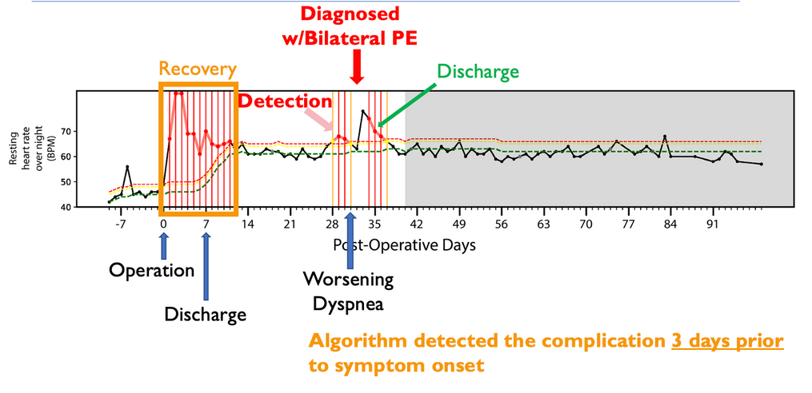
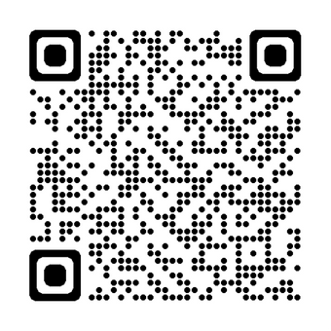
Using Machine Learning Algorithms and Wearable Technology
for the Early Detection of Postoperative Complications After Cardiothoracic Surgery
Meghan McCarthy¹, Jorind Beqari¹, Joseph Powell², Jacob Hurd¹, Danny Wang¹, Alexandra Potter¹, James Cranor¹, Deepti Srinivasan¹, Xiao Li², Chi-Fu Jeffrey Yang¹
¹Massachusetts General Hospital, Boston, MA
²Case Western Reserve University, Cleveland, OH
INTRODUCTION & OBJECTIVE
METHODS CONTINUED:
NIGHTSIGNAL ALGORITHM
RESULTS
RESULTS CONTINUED:
Accurate and easy-to-implement methods to detect complications before symptom onset after cardiothoracic surgery are needed.
The objective of this pilot study was to evaluate whether a machine learning algorithm—previously developed for the early detection of Covid-19—could be extended to the early detection of postoperative complications after cardiothoracic surgery.
311 Eligible Cardiac & Thoracic Surgery Patients
Algorithm Design: Uses a deterministic finite state machine (FSM) based on overnight resting heart rate to detect abnormal increases in resting heartrate.
Alerts
  Green Alert (Normal) - a patient’s average RHR on a certain night within 3 bpm compared to cumulative baseline RHR
  Yellow Alert - a patient’s average RHR on a certain night between 3-4 bpm compared to cumulative baseline RHR
  Red Alert - a patient’s average RHR on a certain night greater than 4 bpm compared to cumulative baseline RHR
120 Declined
to Enroll
True Negative: An example of a true negative detection for a patient with no postoperative clinical events or red alerts.
191 Patients Enrolled
Predicted Label
57 Withdrew Early
4 Terminated due to cancelled surgery
True Negative:
164
False. Positive:
63
The NightSignal algorithm detected 23 out of 27 postoperative events.
METHODS
130 Patients Completed 90-Day Post-op Course
True Label
True Positive:
23
False Negative:
4
Design: Prospective observational cohort study conducted from July 2021 to February 2023
Inclusion Criteria: Patients aged 18 years or older scheduled to undergo cardiothoracic surgery for heart and lung disease.
Exclusion Criteria: Individuals with mental capacity and/or cognitive impairment, specific comorbidities, and/or not owning a smart phone or having an email address.
Wearable Data: Patients were provided with a Fitbit Charge 4 or 5 device, and wore the device for at least 1 week prior to surgery and 90-days postoperatively.
Clinical Data: Patient demographics and pre-, peri-, and post-operative data were collected from electronic medical records. A modified version of the EuroQol5D18 (EQ-5D) daily survey was administered
47 excluded for insufficient biometric data
27 Excluded for experiencing an inpatient complication
Specificity: 0.72
NPV: 0.98
Sensitivity: 0.85
PPV: 0.27
Early Detection
In true positives, the algorithm detected postoperative events a median of 2 (IQR: 0.5 to 3.5) days prior to the onset of symptoms
Number of Patients
Late Detection
OPERATIVE CHARACTERISTICS
20 Patients with Evaluable Post-operative Event
THORACIC (N=24)
36 Patients with No Post-operative Event
  29.2% VATS Lobectomy
  25% Robotic Lobectomy
  16.7% Robotic Segmentectomy
  12.5% VATS Wedge Lobectomy
  8.3% VATS Segementectomy
  8.3% Robotic Wedge Resection
Days Between Documented Postoperative Clinical Event and Nightsignal Alert
TRUE POSITIVE EXAMPLE
CONCLUSIONS
Machine learning analysis of high-resolution RHR data passively collected by wearable devices could detect postoperative events with a sensitivity of 85%, most of which were major postoperative complications.
Most of these complications were identified several days prior to the onset of symptoms related to that complication
CARDIAC (N=32)
  37.5% Open Valve Replacement
  21.9% Non-robotic Minimally Invasive Valve Repair
  15.6% Open Valve Repair
  6.3% Aortic Arch Repair
  6.3% Non-robotic Minimally Invasive Valve Replacement
  6.3% Other
  3.1% Coronary Artery Bypass Graft
  3.1% Robotic Valve Repair
True Positive: A 68-year-old male undergoing minimally invasive mitral valve repair; patient developed bilateral PE on POD 33
The authors have no relevant disclosures or conflicts of interest.
This R01-funded (R01 HL159170) clinical trial is registered with the National Institutes of Health under NCT04824066
Corresponding Author: Chi-Fu Jeffrey Yang
(cjyang@mgh.harvard.edu)

